Slide 1

Predicting Student’s Grade based on Alcohol Consumption Behavior
By
Rajat Handa
Abhishek Misra

Slide 2

Motivation
Death
1,825 college students between the ages of 18 and 24 die from alcohol-related unintentional injuries, including motor-vehicle crashes.
Assault
696,000 students between the ages of 18 and 24 are assaulted by drunk student.
Sexual Assault
97,000 students between the ages of 18 and 24 report experiencing alcohol-related sexual assault or date rape.
www.niaaa.nih.gov

Slide 3
Exploratory Data Analysis

Slide 4
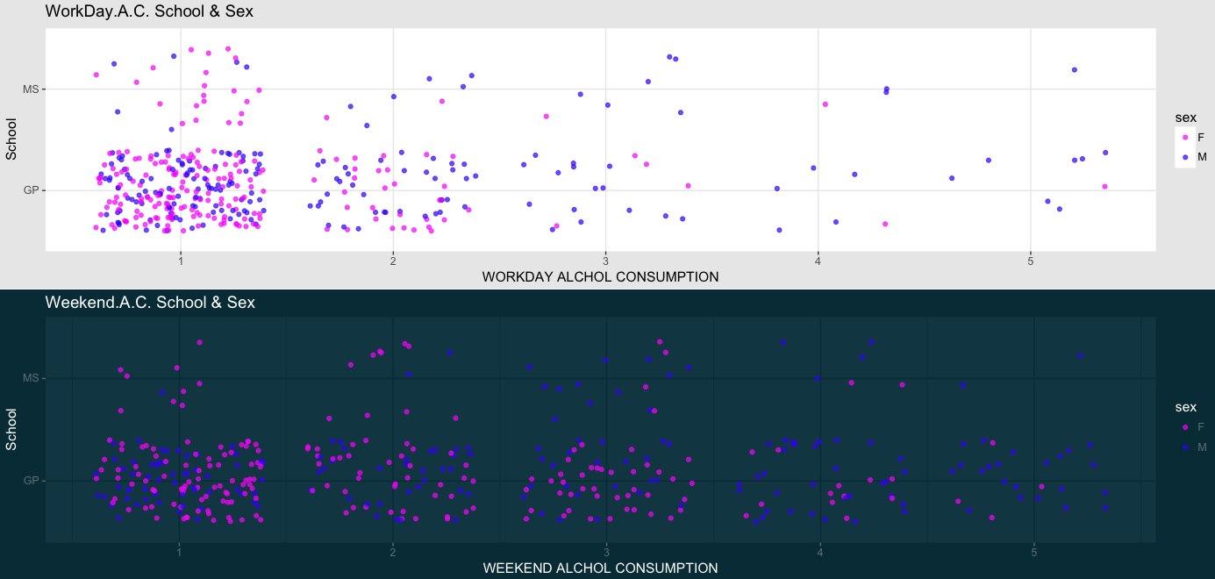
Workday & Weekend Gender Distribution

Slide 5
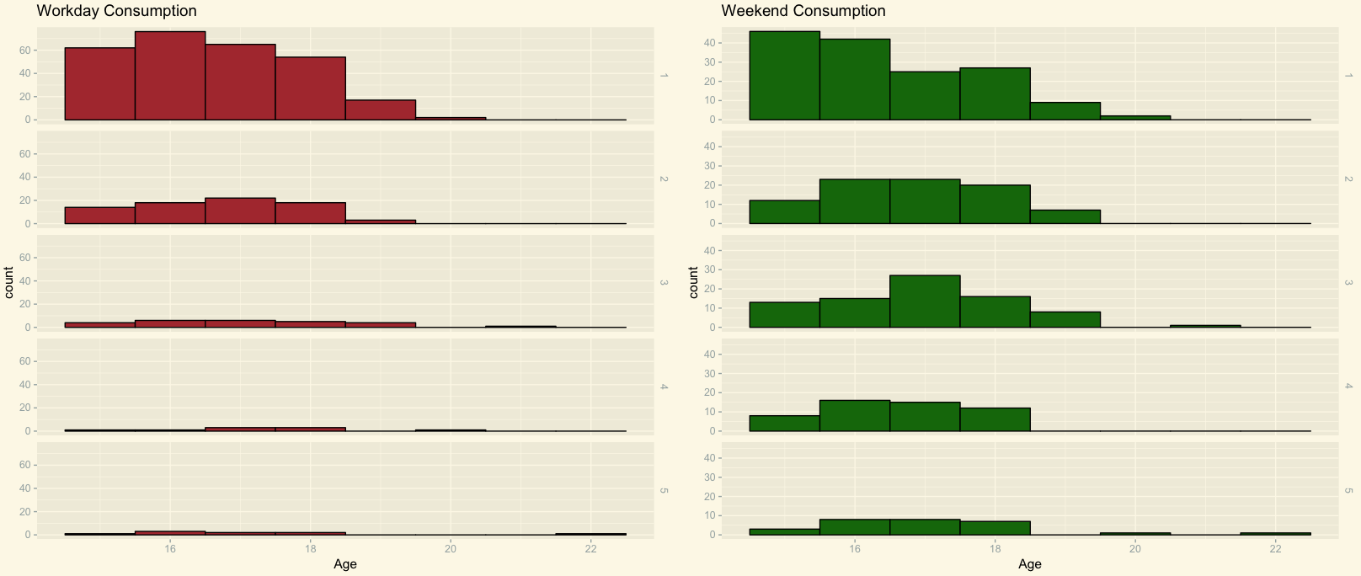
Workday & Weekend Age Distribution

Slide 6
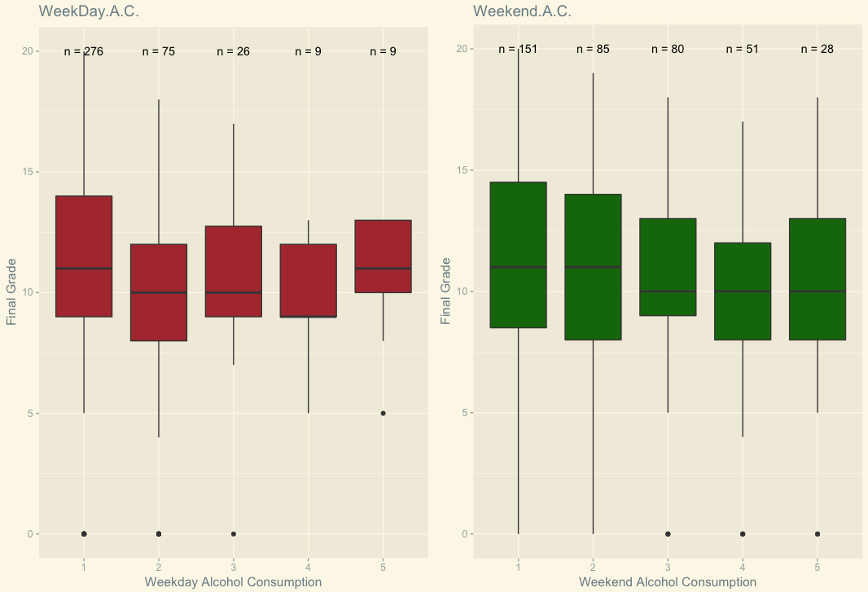
Workday &Weekend Grade Distribution

Slide 7
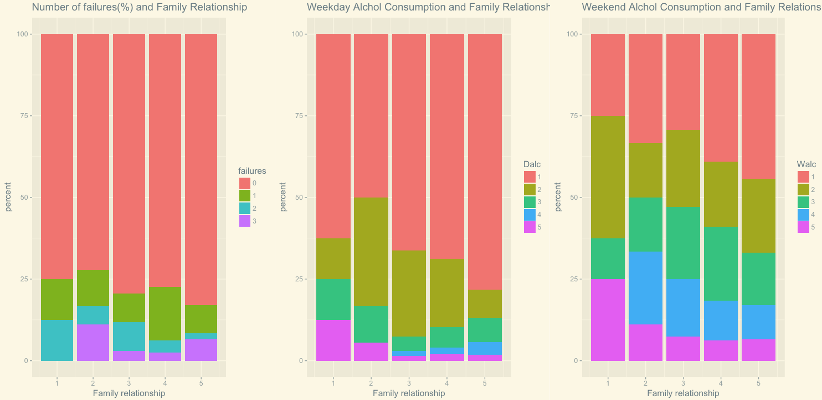
Family relationship , Alcohol Consumption & Failures

Slide 8
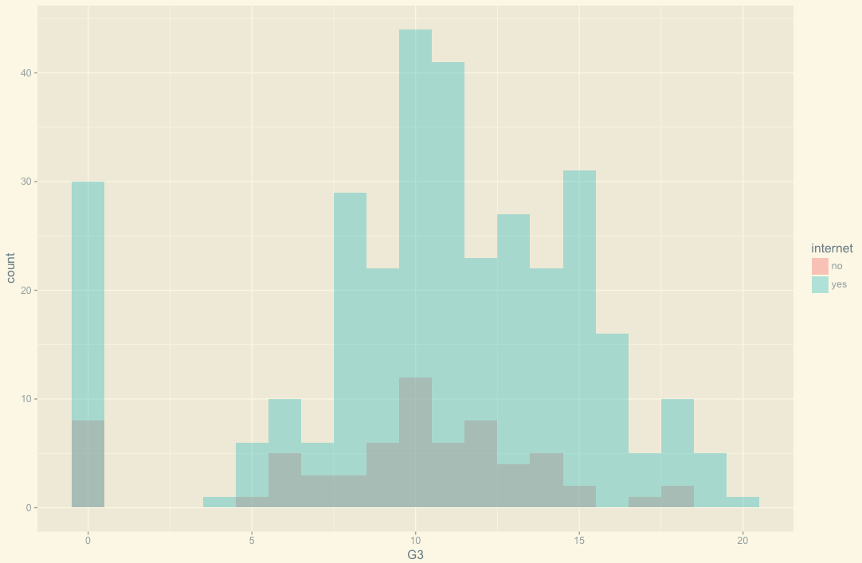
Internet and Grades

Slide 9
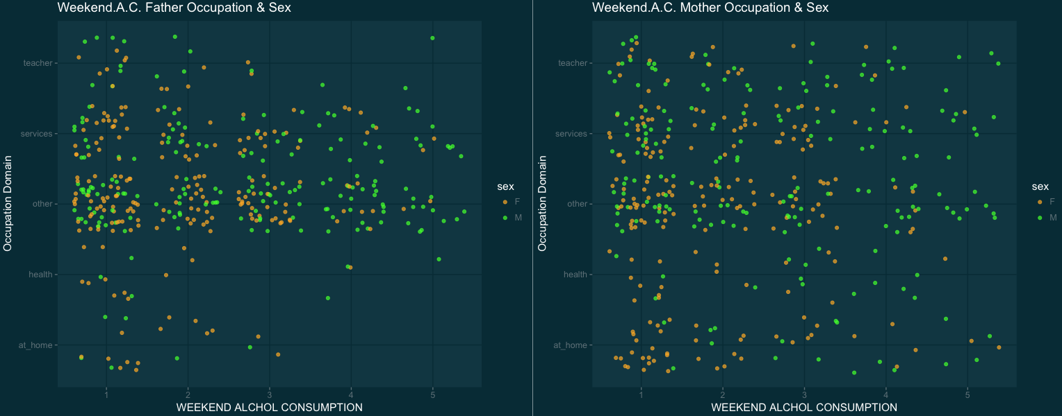
Parent’s Occupation and Alcohol Consumption

Slide 10
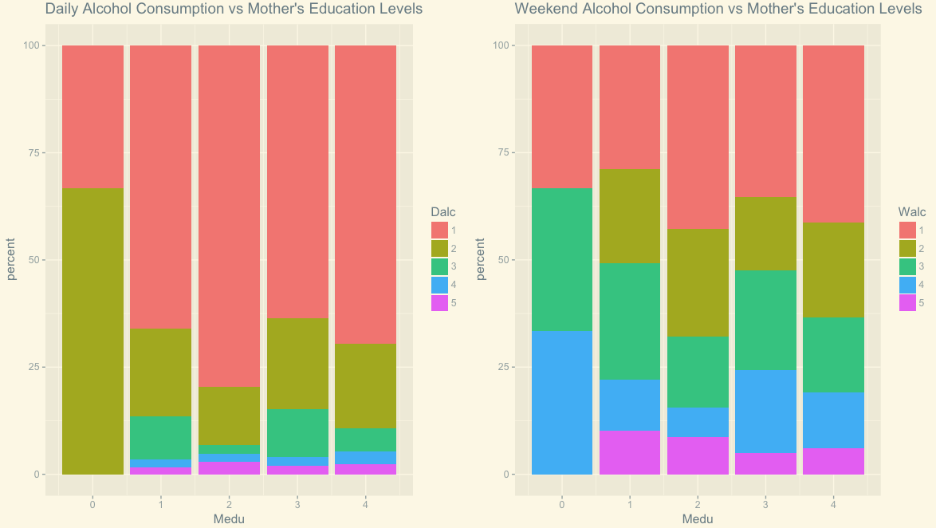
Mother’s Education & Alcohol Consumption

Slide 11
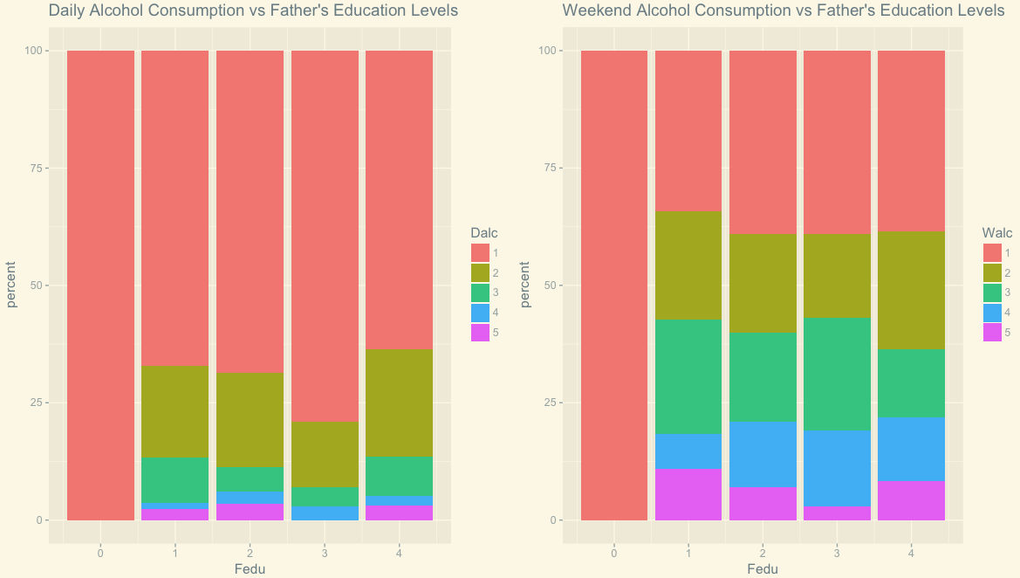
Father’s Education & Alcohol Consumption

Slide 12
Predictive Models

Slide 13
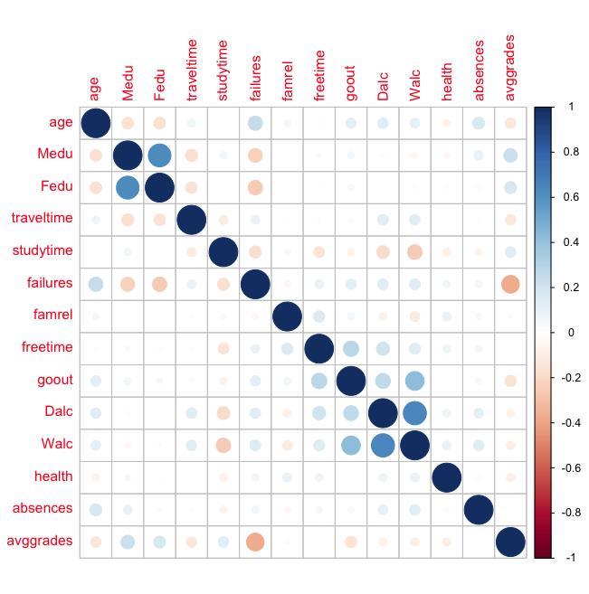
Correlation Plot

Slide 14
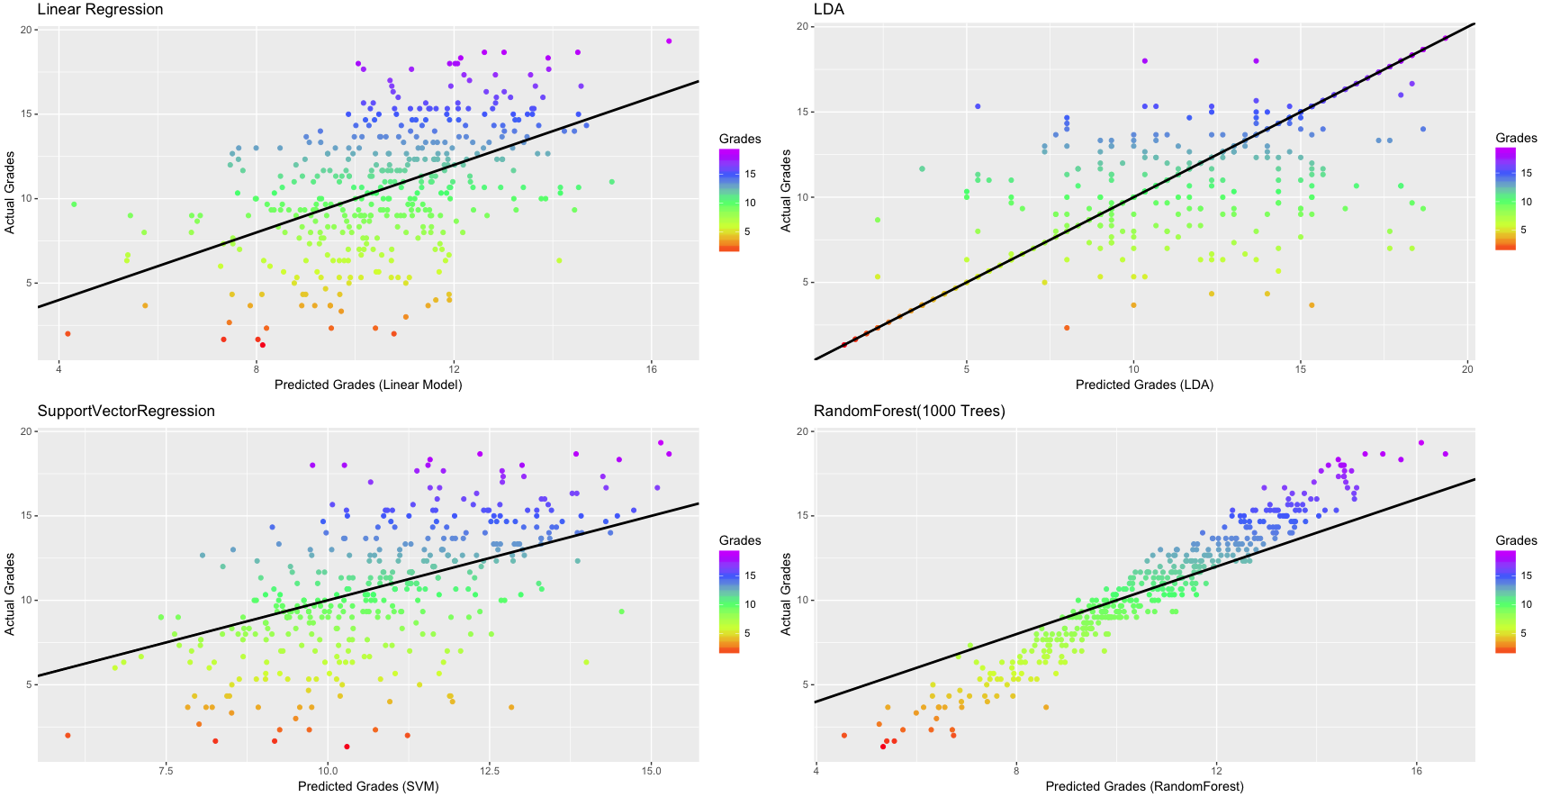
Model Plots

Slide 15
Normalized Mean Square Error
Model Name | NMSE
Linear Model | 0.74
LDA | 0.68
SVM | 0.63
Random Forest | 0.20
Model with lowest NMSE is better model.

Slide 16
Conclusion
Mother’s Education and Father’s Occupation plays an important role in determining alcohol consumption.
Student drink more on weekend.
Alcohol consumption inversely proportional to grades.
Random Forest best method to predict student average grade.
Thank You

